Slide 1


Transport Layer
COMPSCI 453 Computer Networks
Professor Jim Kurose
College of Information and Computer Sciences
University of Massachusetts
Transport-layer services
Multiplexing and demultiplexing
Connectionless transport: UDP
Principles of reliable data transfer
Connection-oriented transport: TCP
Principles of congestion control
TCP congestion control
Evolution of transport-layer functionality
Class textbook:
Computer Networking: A Top-Down Approach (8th ed.)
J.F. Kurose, K.W. Ross
Pearson, 2020
http://gaia.cs.umass.edu/kurose_ross

Slide 2
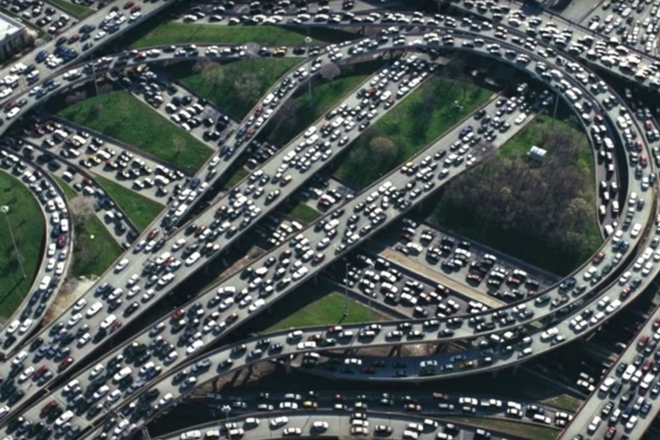


Principles of congestion control
Congestion:
informally: “too many sources sending too much data too fast for network to handle”
manifestations:
long delays (queueing in router buffers)
packet loss (buffer overflow at routers)
different from flow control!
congestion control: too many senders, sending too fast
a top-10 problem!
flow control: one sender too fast for one receiver

Slide 3

Causes/costs of congestion: scenario 1
original data: λ_{in}
throughput: λ_{out}
Simplest scenario:
Host A
one router, infinite buffers
input, output link capacity: R
infinite shared output link buffers
two flows
R
R
no retransmissions needed
Host B
R/2
Q: What happens as arrival rate λ_{in} approaches R/2?
λ_{out}
delay
throughput:
λ_{in}
R/2
λ_{in}
R/2
maximum per-connection throughput: R/2
large delays as arrival rate λ_{in} approaches capacity
R/2

Slide 4
Causes/costs of congestion: scenario 2
one router, finite buffers
sender retransmits lost, timed-out packet
application-layer input = application-layer output: λ_{in} = λ_{out}
transport-layer input includes retransmissions : λ’_{in} λ_{in}
Host A
λ_{in} : original data
λ'_{in}: original data, plus retransmitted data
λ_{out}
R
R
Host B
finite shared output link buffers

Slide 5
Causes/costs of congestion: scenario 2
Idealization: perfect knowledge
sender sends only when router buffers available
R/2
λ_{out}
throughput:
Host A
λ_{in} : original data
λ_{in}
copy
λ'_{in}: original data, plus retransmitted data
λ_{out}
R/2
free buffer space!
R
R
Host B
finite shared output link buffers

Slide 6
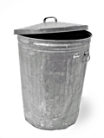
Causes/costs of congestion: scenario 2
Idealization: some perfect knowledge
packets can be lost (dropped at router) due to full buffers
sender knows when packet has been dropped: only resends if packet known to be lost
Host A
λ_{in} : original data
copy
λ'_{in}: original data, plus retransmitted data
no buffer space!
R
R
Host B
finite shared output link buffers

Slide 7
Causes/costs of congestion: scenario 2
Idealization: some perfect knowledge
packets can be lost (dropped at router) due to full buffers
sender knows when packet has been dropped: only resends if packet known to be lost
R/2
λ_{out}
“wasted” capacity due to retransmissions
when sending at R/2, some packets are needed retransmissions
throughput:
Host A
λ_{in} : original data
λ_{in}
λ'_{in}: original data, plus retransmitted data
R/2
free buffer space!
R
R
Host B
finite shared output link buffers

Slide 8


Causes/costs of congestion: scenario 2
Realistic scenario: un-needed duplicates
packets can be lost, dropped at router due to full buffers – requiring retransmissions
but sender times can time out prematurely, sending two copies, both of which are delivered
R/2
λ_{out}
“wasted” capacity due to un-needed retransmissions
throughput:
when sending at R/2, some packets are retransmissions, including needed and un-needed duplicates, that are delivered!
Host A
λ_{in} : original data
λ_{in}
copy
λ'_{in}: original data, plus retransmitted data
R/2
timeout
free buffer space!
R
R
Host B
finite shared output link buffers

Slide 9
Causes/costs of congestion: scenario 2
Realistic scenario: un-needed duplicates
packets can be lost, dropped at router due to full buffers – requiring retransmissions
but sender times can time out prematurely, sending two copies, both of which are delivered
R/2
λ_{out}
“wasted” capacity due to un-needed retransmissions
throughput:
when sending at R/2, some packets are retransmissions, including needed and un-needed duplicates, that are delivered!
λ_{in}
R/2
“costs” of congestion:
more work (retransmission) for given receiver throughput
unneeded retransmissions: link carries multiple copies of a packet
decreasing maximum achievable throughput

Slide 10
Causes/costs of congestion: scenario 3
four senders
multi-hop paths
timeout/retransmit
Q: what happens as λ_{in} and λ_{in}’ increase ?
A: as red λ_{in}’ increases, all arriving blue pkts at upper queue are dropped, blue throughput g 0
Host A
λ_{in} : original data
λ'_{in}: original data, plus retransmitted data
Host B
finite shared output link buffers
Host D
λ_{out}
Host C

Slide 11
Causes/costs of congestion: scenario 3
R/2
λ_{out}
λ_{in}’
R/2
another “cost” of congestion:
when packet dropped, any upstream transmission capacity and buffering used for that packet was wasted!

Slide 12
Causes/costs of congestion: insights
throughput can never exceed capacity
delay increases as capacity approached
loss/retransmission decreases effective throughput
un-needed duplicates further decreases effective throughput
upstream transmission capacity / buffering wasted for packets lost downstream

Slide 13
Approaches towards congestion control
End-end congestion control:
no explicit feedback from network
congestion inferred from observed loss, delay
ACKs
data
data
ACKs
approach taken by TCP

Slide 14
Approaches towards congestion control
Network-assisted congestion control:
routers provide direct feedback to sending/receiving hosts with flows passing through congested router
may indicate congestion level or explicitly set sending rate
explicit congestion info
ACKs
data
data
ACKs
TCP ECN, ATM, DECbit protocols

Slide 15

Transport Layer
COMPSCI 453 Computer Networks
Professor Jim Kurose
College of Information and Computer Sciences
University of Massachusetts
Transport-layer services
Multiplexing and demultiplexing
Connectionless transport: UDP
Principles of reliable data transfer
Connection-oriented transport: TCP
Principles of congestion control
TCP congestion control
Evolution of transport-layer functionality
Class textbook:
Computer Networking: A Top-Down Approach (8th ed.)
J.F. Kurose, K.W. Ross
Pearson, 2020
http://gaia.cs.umass.edu/kurose_ross
Video: 2020, J.F. Kurose, All Rights Reserved
Powerpoint: 1996-2020, J.F. Kurose, K.W. Ross, All Rights Reserved

Slide 16
Backup

Slide 17
Principles of Congestion Control
Causes and costs of congestion: three scenarios
Approaches towards congestion control:
end-end congestion control
network-assisted congestion control
PIP

Slide 18
Host A
λ_{in} : original data
copy
λ'_{in}: original data, plus retransmitted data
no buffer space!
R
R
Host B
finite shared output link buffers

Slide 19
Causes/costs of congestion: scenario 3
four senders
multi-hop paths
timeout/retransmit
Q: what happens as λ_{in} and λ_{in}’ increase ?
Host A
λ_{in} : original data
λ'_{in}: original data, plus retransmitted data
Host B
first-hop
second-hop
Host D
λ_{out}
Host C

